Slide 1
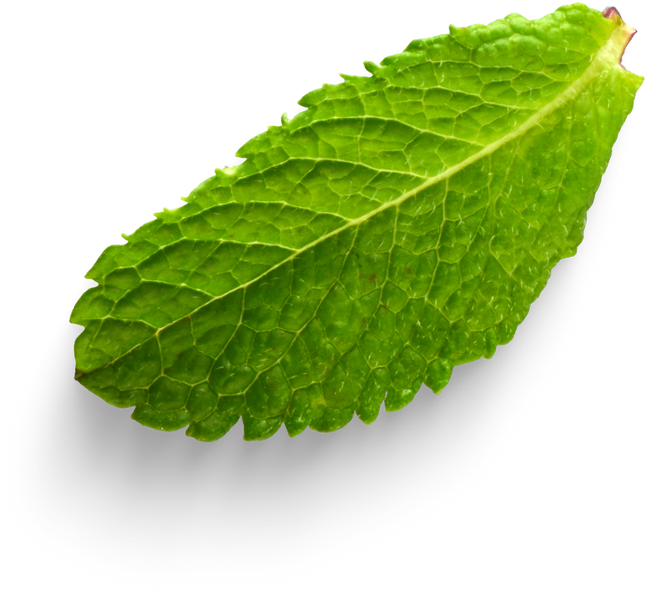
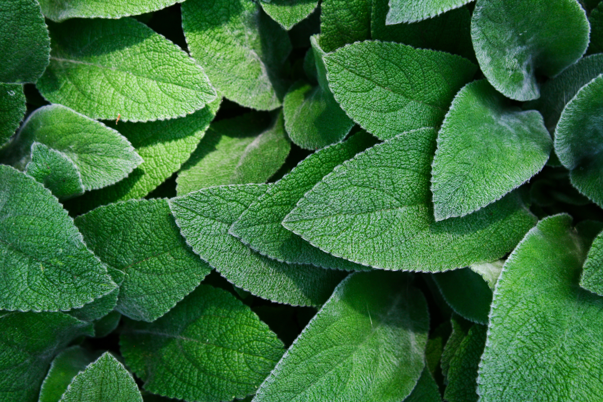

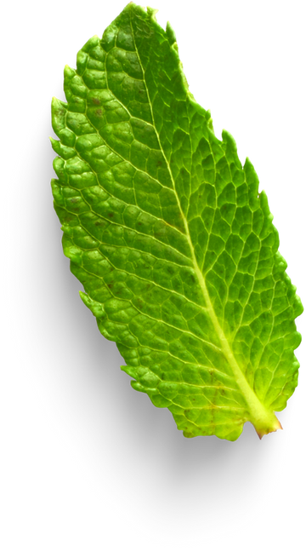
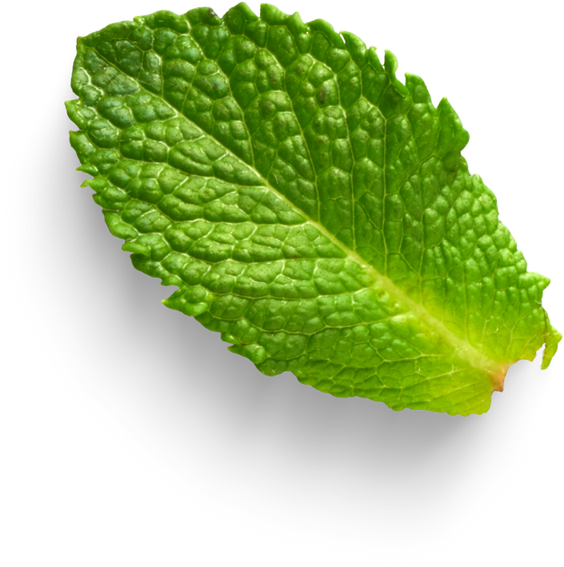

PLANT DISEASE DETECTION
CSE 299
Faculty: Shafayat Osman
Presented by:
Monjurul Islam
2232339042
Md Shihabul Alam
Shihab
2233115642

Slide 2
INTRODUCTION
Every year, many crops are damaged because diseases are not identified correctly or on time, which causes financial loss for farmers. To solve this problem, we have developed a Plant Disease Prediction System that can detect crop diseases quickly and accurately. This system helps farmers identify diseases early, get solution, suggested pesticide and use chatbot for more information which help the users to take the right actions, and reduce their losses.

Slide 3
MOTIVATION
Plant diseases cause huge crop losses worldwide.
Early detection helps farmers save crops and improve yield.
Manual inspection is slow and error-prone, AI can assist efficiently.
Users will be suggested right pesticide where sometime manually suggested wrong.

Slide 4
Project Overview
This project focuses on building a plant disease classification system using deep learning, where leaf images are analyzed to detect 27 different plant diseases using MobileNetV2.
Technologies
Programming Language: Python
Deep Learning & Machine Learning: TensorFlow / Keras ,
MobileNetV2 (Transfer Learning)
Image Processing: OpenCV, PIL (Python Imaging Library)
Web Application Framework: Streamlit
Data Handling & Utilities: NumPy, Pandas, JSON, OS module
AI Integration: Google Generative AI (Gemini API)
Others: DateTime (for logging predictions)

Slide 5
Project Workflow
01
Collect Dataset
02
Data Cleaning and Preprocessing
03
Model building(CNN) For Train and Test the Data
04
Deploy the model as a web application

Slide 6
Dataset configuration
Classes: 27 plant disease types (corn, tomato, potato, apple, grape, strawberry, etc.)
Total samples: 10,800 images (400 per class)
Data split:
Training: 7,560 images (280/class) 80%
Validation: 1,620 images (60/class) 20%
Test: 1,620 images (60/class)
Image size: 224×224 pixels
Dataset is balanced: with equal samples per class

Slide 7
Implimentation
Dataset collected from Kaggle
Images resized, normalized, and augmented before training
Pretrained MobileNetV2 used for feature extraction
Custom classification layers added to reduce overfitting
Model evaluated using training and validation accuracy
Trained model predicts diseases from unseen leaf images
Disease-specific pesticide recommendations provided
Chatbot support available for additional user guidance

Slide 8
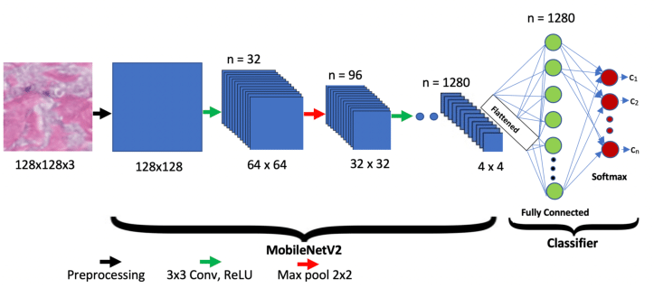
MODEL ARCHITECTURE
Base model: MobileNetV2 (pretrained on ImageNet, frozen initially)
Custom classifier:
- Average pooling from base model
- BatchNormalization
- Dropout (0.2)
- Dense layer (256 units, ReLU, L2 regularization)
- BatchNormalization
- Dropout (0.2)
- Output layer (27 classes, softmax, L2 regularization)

Slide 9
Training Details
Phase 1 (5 epochs):
- Freeze base MobileNetV2
- Train custom classifier only
- Learning rate: 5e-4
- Optimizer: AdamW with weight decay
Phase 2 (15 epochs):
- Unfreeze last 50 layers of base model
- Fine-tune with lower learning rate: 1e-4
- Continue training for better feature extraction

Slide 10
Training Details
Anti-Overfitting Techniques
Dropout (0.2) applied twice in the classifier
L2 regularization (weight decay = 5e-4) on dense layers
Label smoothing (0.1) to avoid overconfident predictions
Batch normalization layers for training stability
Early stopping with patience of 5 epochs
Learning rate scheduling using ReduceLROnPlateau
Pre-augmented dataset (no runtime augmentation)
Training Configuration
Batch size: 32
Total epochs: 20
Optimizer: AdamW
Loss function: Categorical cross-entropy with label smoothing
Evaluation metrics: Accuracy and Top-3 accuracy
Class weights used for balanced training
Fixed random seed (42) for reproducibility

Slide 11
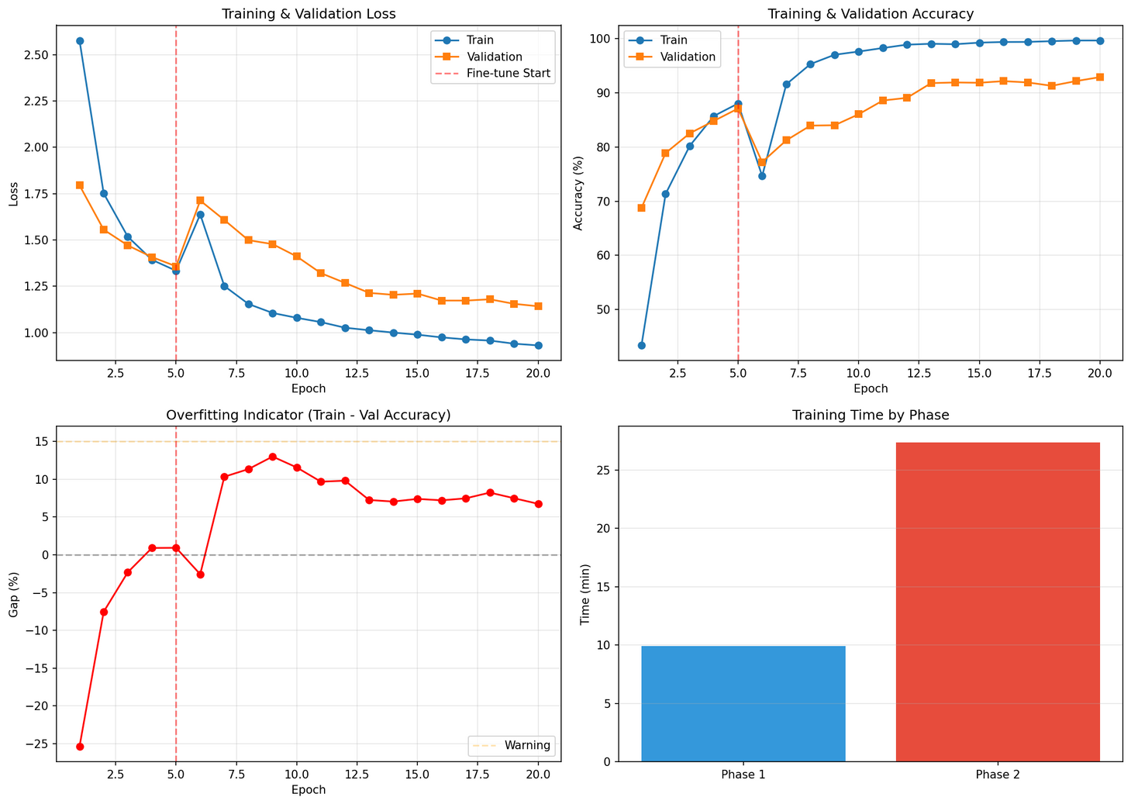
Evaluation & Results

Slide 12
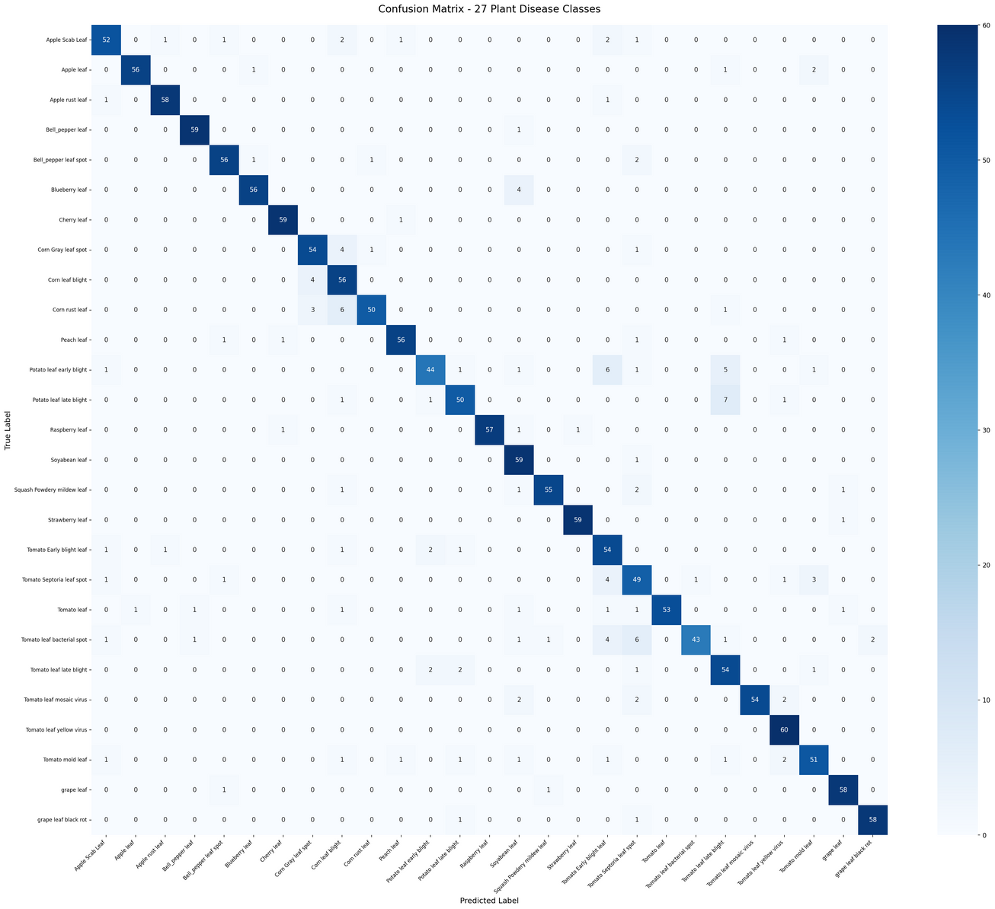
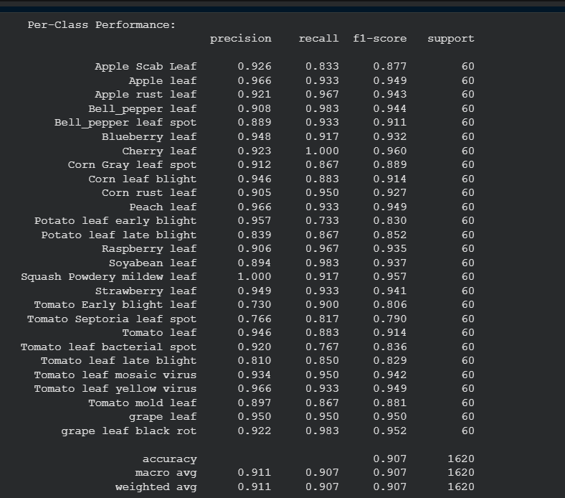
Evaluation & Results

Slide 13
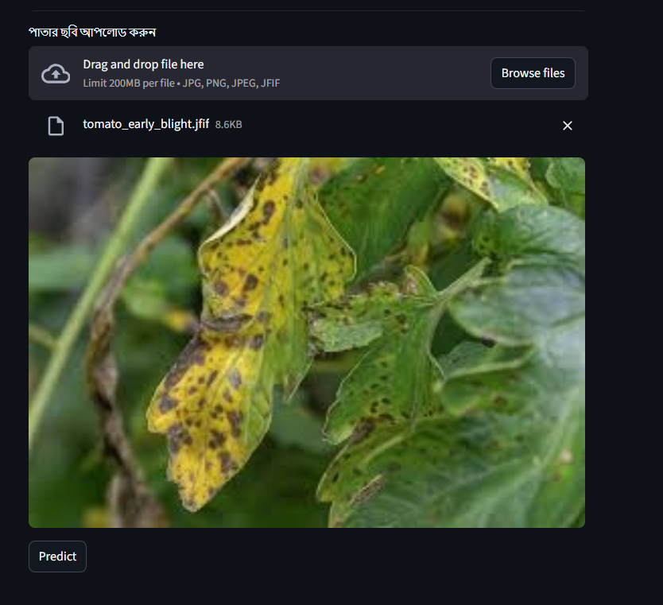
Prediction / Demo
Input:
Tomato early blight

Slide 14
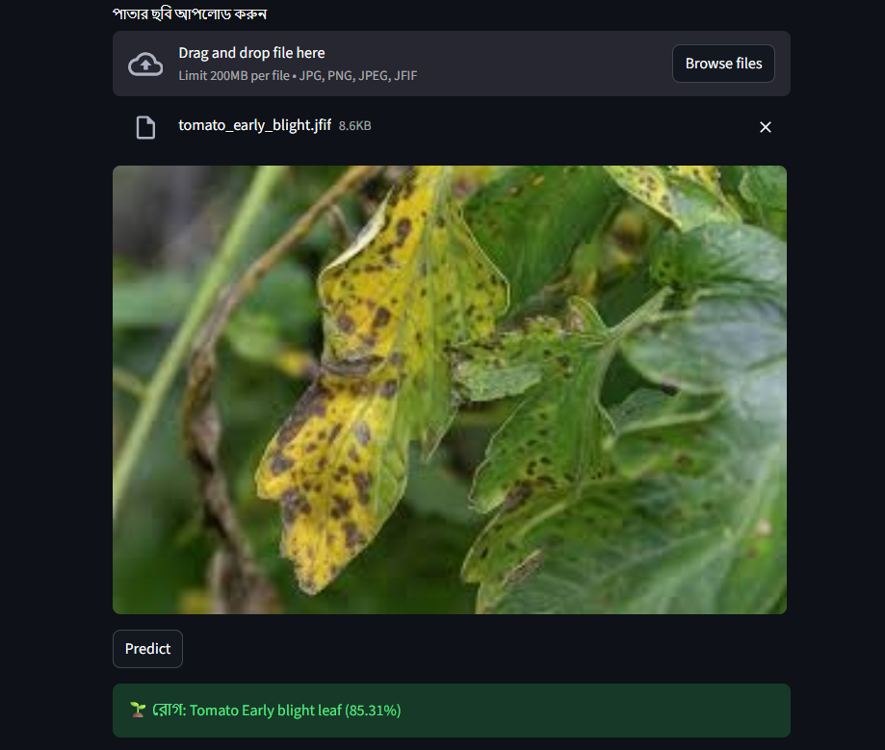
Output:

Slide 15
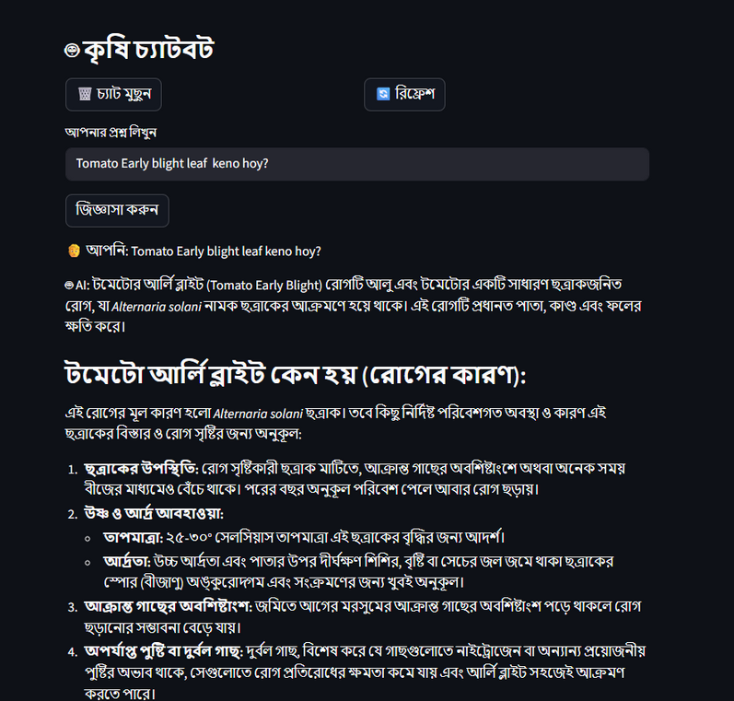
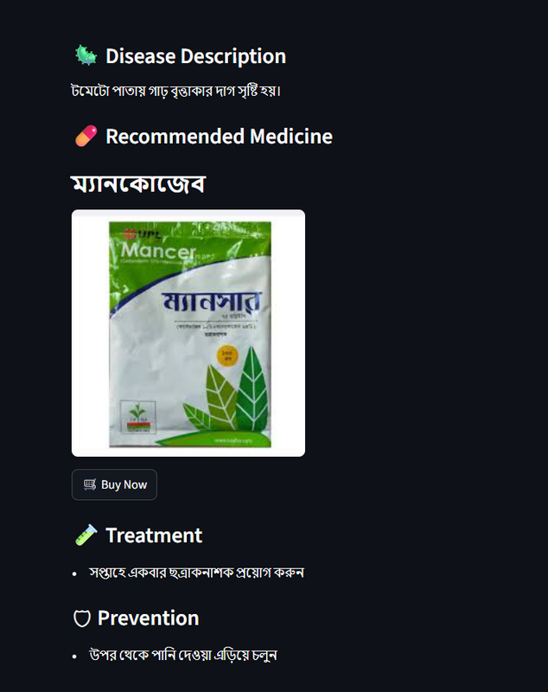
Some Features

Slide 16
Benefits and limitation
Benefit
Early disease detection for farmers
Reduced crop loss
Reduced pesticide overuse
Supports sustainable agriculture
Get immeditae soluation and treatment (Pesticite suggestion)
Users can use the Chatbot
Limitation
Performance depends on image quality
Limited dataset
Similar disease symptoms may confuse model

Slide 17
Future Work
Mobile app integration
Real-time detection
More crop and disease classes
Field deployment

Slide 18
Conclusion
This project shows how deep learning can be used to help agriculture by detecting plant diseases quickly and accurately. By using the MobileNet model, the system can analyze leaf images and identify diseases at an early stage. This helps farmers take timely action, reduce crop loss, and improve overall crop health. The approach is efficient, cost-effective, and suitable for real-world agricultural applications.

Slide 19
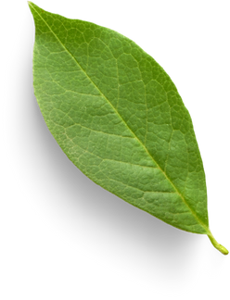
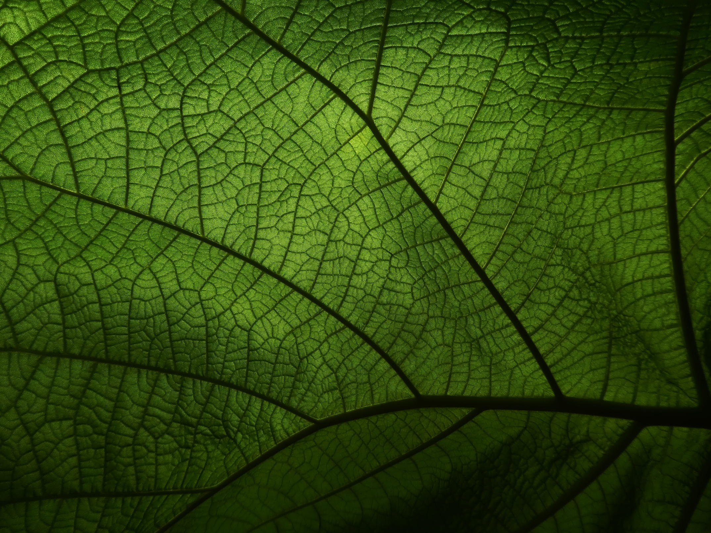
Thank You

